Slide 1
Reconstructing and predicting stochastic dynamical systems using probabilistic deep learning
Journal Club
Will An

Slide 2
Introduction
This paper builds on the idea of taken’s theorem where states that a limited observation of a dynamical system can be used to reconstruct the full phase space.
With the help of deep learning, it extracts the stochastic features while preserving the underlying dynamical structure.
By utilizing temporal convolutional network (TCN), it can predict based on long-range temporal dependencies.

Slide 3
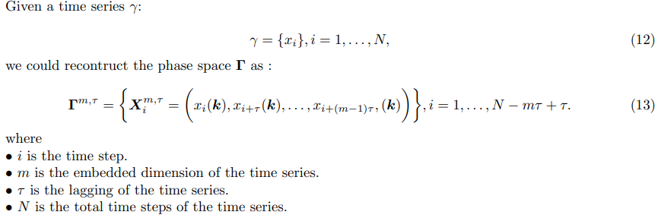
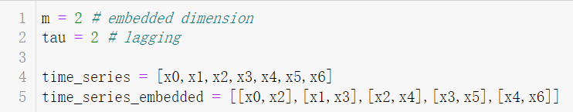
Introduction – Taken’s Theorem
Limited observations of state variables can retain the Lyapunov exponent by proper lag-embedding.

Slide 4
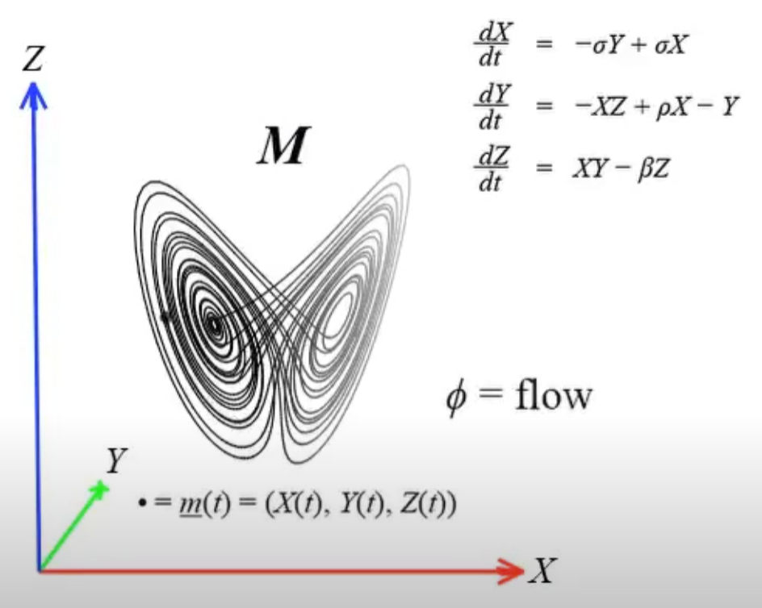
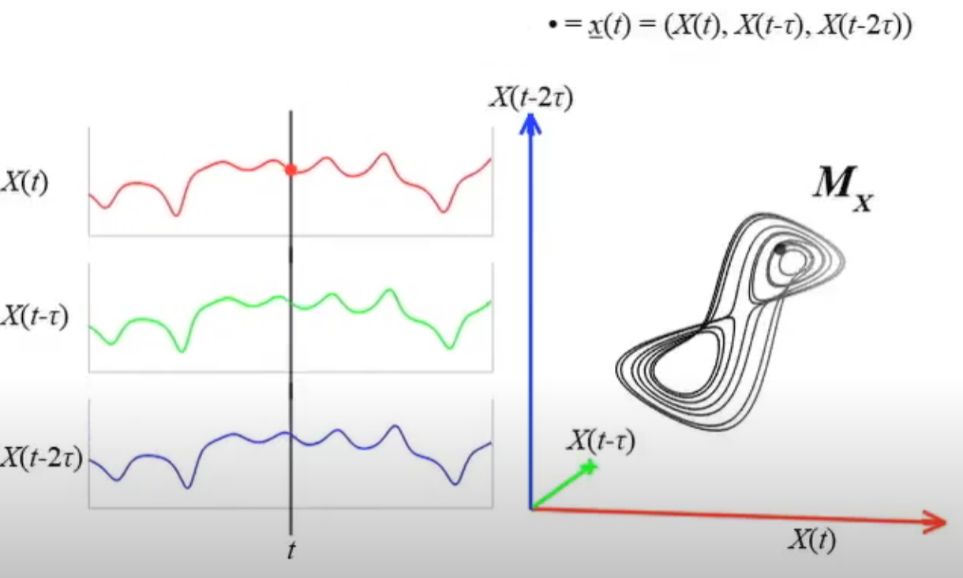
Introduction – Taken’s Theorem
https://www.youtube.com/watch?v=6i57udsPKms&t=40s
Sugihara, George, et al. "Detecting causality in complex ecosystems." science 338.6106 (2012): 496-500.

Slide 5
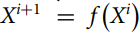
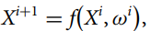
Introduction – Stochastic dynamical system
Normal case: (X^{i} means all state variables at time i)
Stochastic case: (ω is white noise)

Slide 6
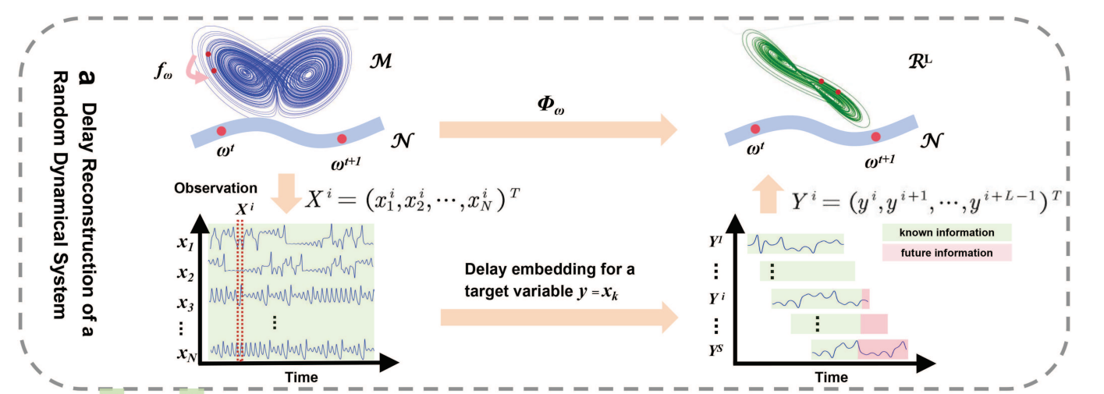
Method – lag-embedding
Original phase space
Reconstructed phase space
Time i
Reconstruction with L pre-decided
Limited observation
N state variables

Slide 7
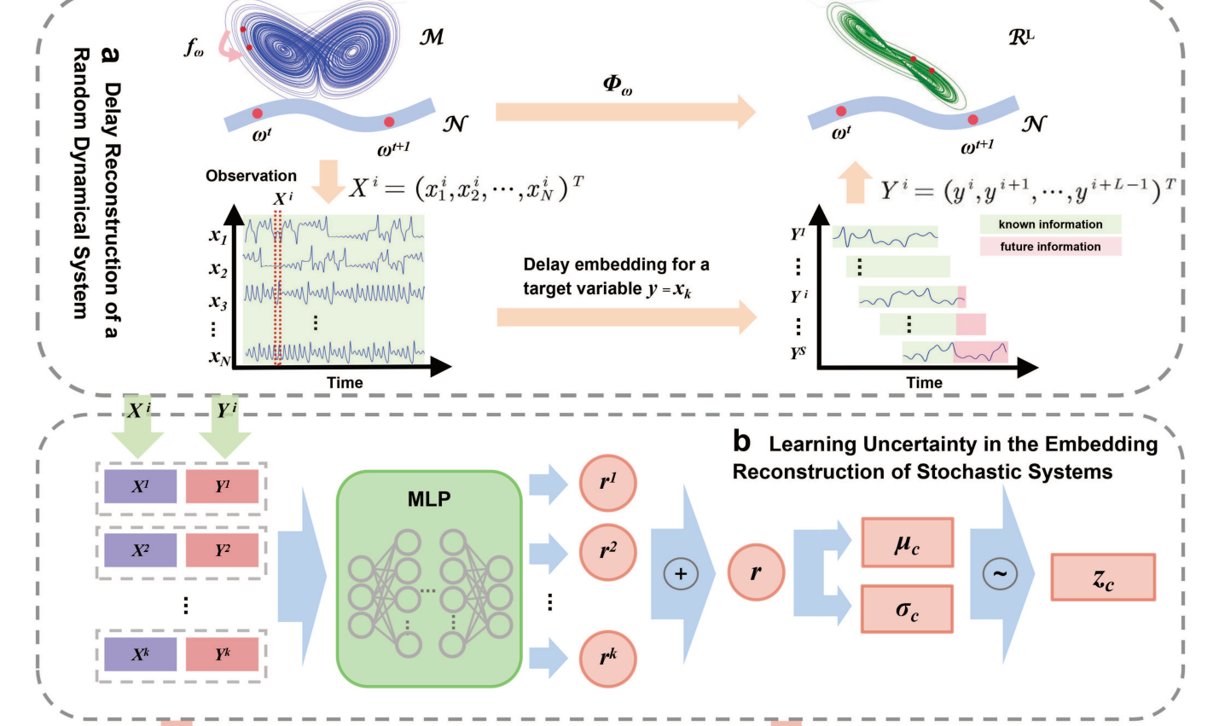
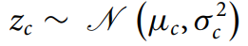
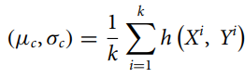
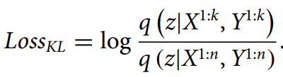
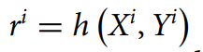
Method – Extract Stochastic Feature
Concatenate X and Y
Train based on first k time steps

Slide 8
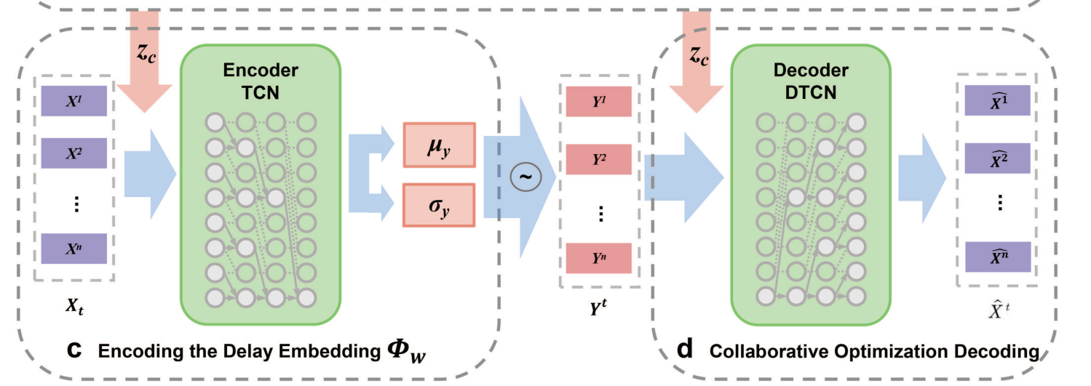
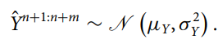
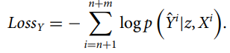
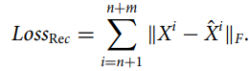
Method – TCN with stochasticity info

Slide 9
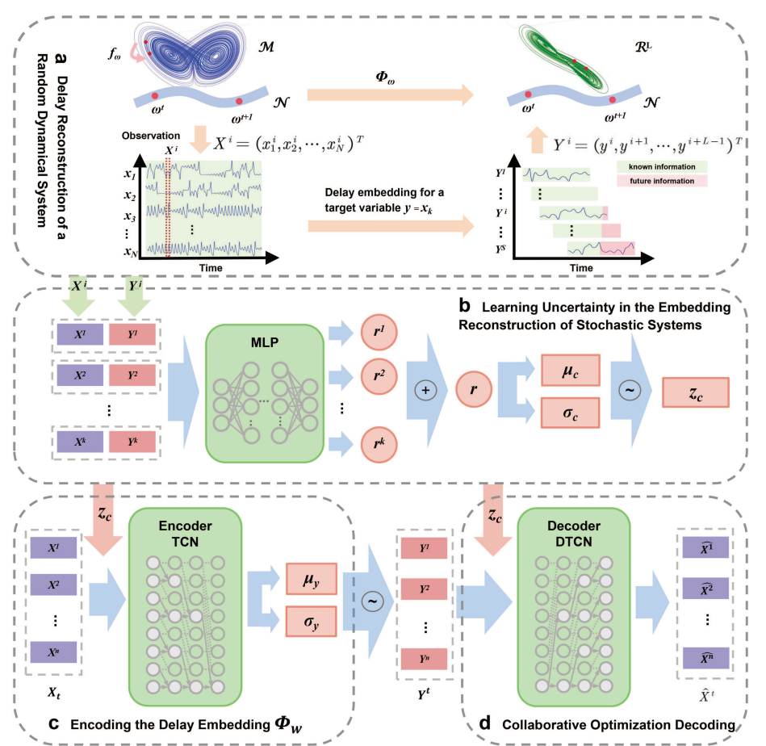
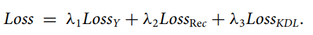
Method – Model Training

Slide 10

Method - Summary
For a dynamical system, with time range [1,n], full state space X, target variable Y
X
Deep Learning
X
Deep Learning
z
$$\hat{Y}$$
Y
Y
[1,k] k << n
[1,n]
[n,n+m]

Slide 11
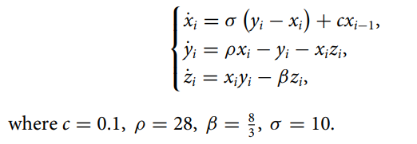
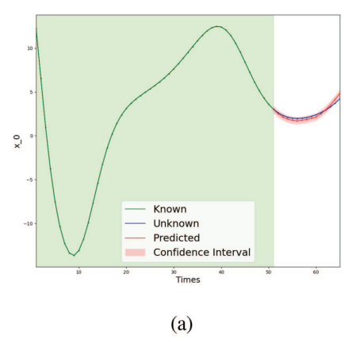
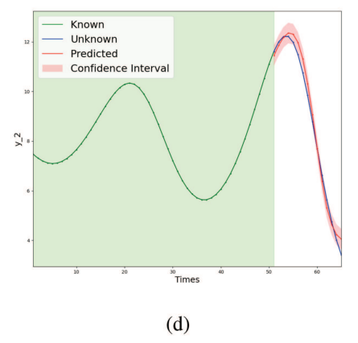
Results – Coupled Lorentz System
i = 1,2,…,30
Dimension = 90
Noise free
y_1

Slide 12
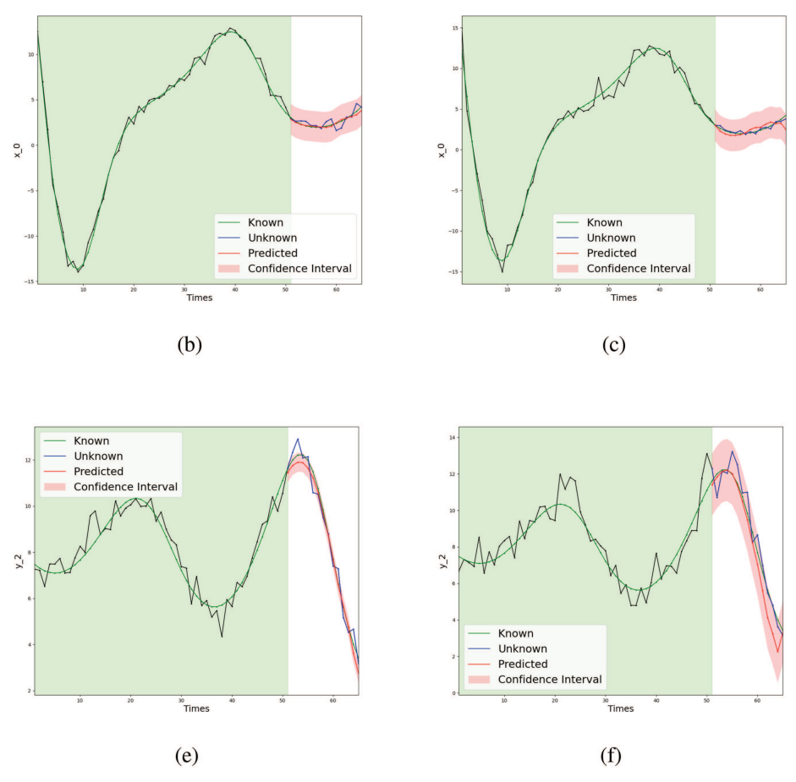
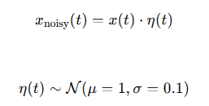
Results – Coupled Lorentz System
b,e: σ = 0.5
c,f: multiplicative white noise (µ = 1, σ = 0.1)

Slide 13
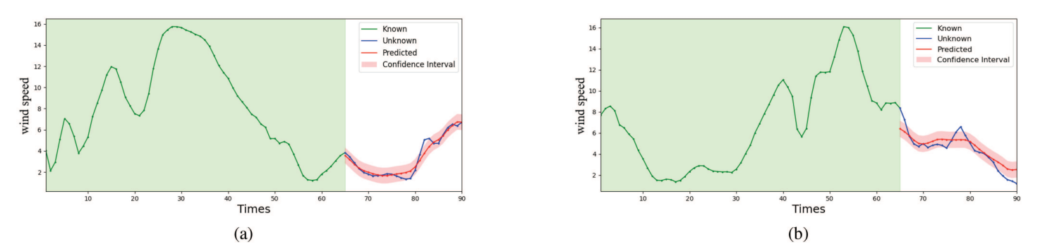
Results – Wind Speed
Measured every 10 min at 155 wind stations across Japan.
So it assumes full state space = 155 wind stations (X)
It randomly selects a target station to predict (Y)
Two different periods, same station (Y)

Slide 14
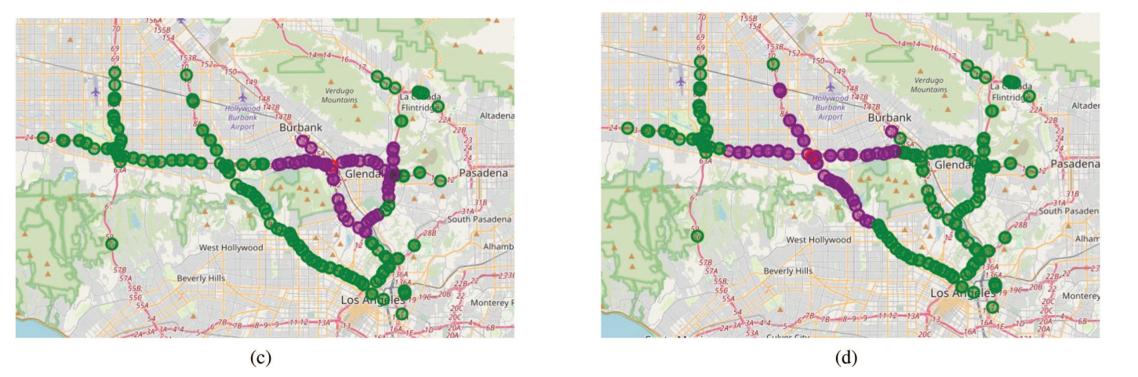
Results – Traffic Speed
207 loop detectors along Highway 134 in California, USA, recorded every 5 min. 55 nearest-neighbor detectors were selected for each target sensor.
So Y is the red dot. X are 55 purple nearby points.

Slide 15
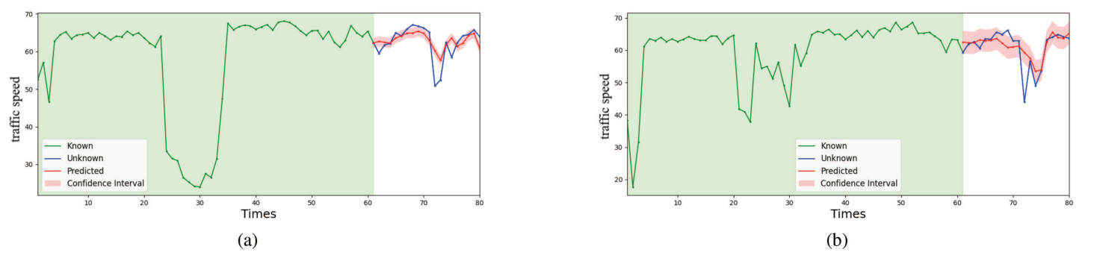
Results – Traffic Speed

Slide 16
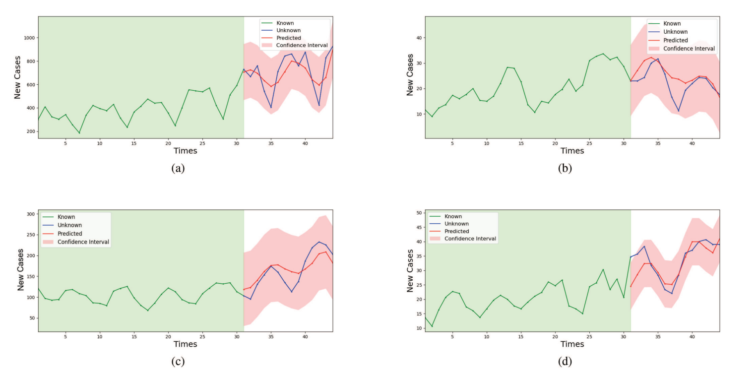
Results – Covid 19
Based on data from all 47 districts in Japan, the forecasts of daily new COVID-19 cases for four target cities are shown in Fig. 6(a) (Tokyo), Fig. 6(b) (Tochigi), Fig. 6(c) (Kanagawa), and Fig. 6(d) (Gunma).

Slide 17
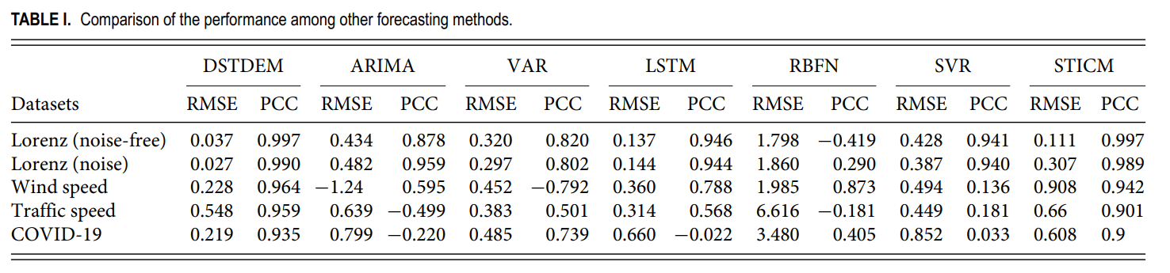
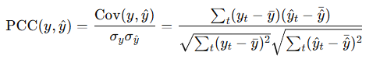
Results - Overall

Slide 18
Conclusion
The DSTDEM is grounded in the embedding reconstruction theory and incorporates an advanced deep probabilistic framework, offering a novel perspective for analyzing high-dimensional time-series data.
The DSTDEM effectively captures features across different time scales in time series using the temporal convolution structure.
Also, it effectively extracts stochastic features from historical time-series data.
DSTDEM has been validated through applications in various real-world scenarios

